Slide 1


Loops

Slide 2
All Programming Languages Must:
Run in a given order – Execute
Remember things – Store Variables and Data
Make choices – Flow Control
Repeat things – Loop, Recursion

Slide 3
Loops are the repetition rule:
Run in a given order
Remember things
Make choices
Repeat things

Slide 4
Loops will repeat code a certain number of times.

Slide 5
There are 2 kinds of loops:
1. Repeat code exactly # times
2. Repeat code until something is False.
Notes:
1. We know how many times we want to repeat
2. We don’t know how many times we want to repeat, but we know we want to repeat until something happens

Slide 6
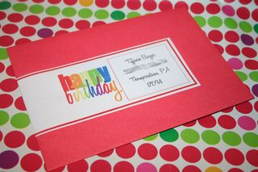
Example 1: repeat exactly # times
For all 100 birthday invitations:
lick stamp
place on envelope
Notes:
We know how many times we want to send a birthday invitation, exactly 100, no more, no less!

Slide 7
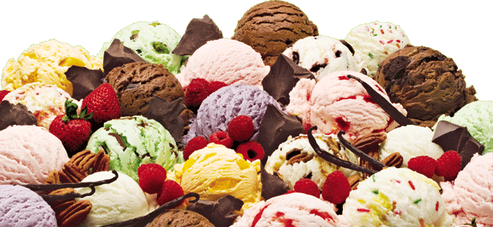
Example 2: repeat until something is False
I loooove ice cream!
while I still have ice cream:
scoop up ice cream
place ice cream in mouth
eat ice cream
Notes:
We don’t know how many scoops it takes to finish the ice cream, but we want to repeat the scoops until the ice-cream is finished. It might take 10, 15 or 27 scoops!
We don’t know exactly but we know that it is a loop that will repeat until the ice cream is finished.

Slide 8
When do I use a loop?
If you find yourself doing the same process over and over again (e.g. repeating) then it might be time to use a loop!

Slide 9
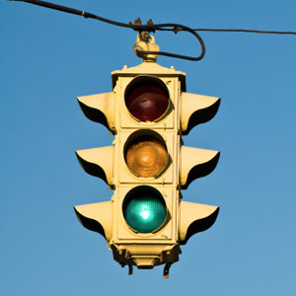
Loops in software:
Traffic light
Notes:
Photo burst takes many photos in response to one button press. It uses a loop to repeat the process of taking one photo
A traffic light goes from Green, to Amber then to Red then repeats the same process using a loop.

Slide 10
Loop Structure
All loops have
A condition (when the loop stops and starts)
A body (what is being repeated)

Slide 11
Condition/Repetition Limit
for all 100 invitations:
lick stamp
place on envelope
Notes:
Emphasize on the structure of the condition. Here the condition is exact, a 100 times!

Slide 12
Body
for all 100 invitations:
lick stamp
place on envelope

Slide 13
Condition/Repetition Limit
while I still have ice cream:
scoop up ice cream
place ice cream in mouth
eat ice cream
Notes:
Emphasize on the structure of the condition. Here the condition is not exact, until ice-cream is gone!

Slide 14
Body
While I still have ice cream:
scoop up ice cream
place ice cream in mouth
eat ice cream

Slide 15
What examples of loops can you think of
e.g.
While I am alive, breathe
For each piece of meat on my plate, eat
While the tutor is talking, listen

Slide 16
Structure of a while loop
while (condition):
#instructions
#This means while this condition is True, keep repeating the instructions below
These instructions will be executed as long as the condition is True

Slide 17
Applying the while loop
while (ice cream is still there):
scoop up ice cream
place ice cream in mouth
eat ice cream
Notes:
Explain that the loop stops when the (condition) becomes False
In this case, the condition becomes False when the ice cream is finished

Slide 18
Python Loops
i = 0
while i < 5:
print(“Zim Code")
i = i +1
This is a while loop to print “Zim Code" 5 times. But how does it work?

Slide 19
Python Loops
i = 0
while i < 5:
print("Zim Code")
i = i + 1
This first part defines the starting condition. What happens if it is not there? What is i?
Notes:
Use the next slide to explain the starting condition

Slide 20
Applying the while loop
ice_cream = 0 #0 means there is ice cream, 1 means it is finished
while (ice_cream == 0):
scoop up ice cream
place ice cream in mouth
eat ice cream
Notes:
Explain that the purpose of the initial condition is to tell the computer that ice cream is there so that the while loop is True on the first try

Slide 21
Python Loops
i = 0
while i < 5:
print("Zim Code")
i = i + 1
i is just an ordinary variable

Slide 22
Python Loops
i = 0
while i < 5:
print("Zim Code")
i = i + 1
This line defines when the loop will stop.
Notes:
The condition here is that so long as i is less than 5, we will keep printing
In other words, we want to keep printing until i is equal to or greater than 5

Slide 23
Python Loops
i = 0
while i < 5:
print("Zim Code")
i = i + 1
This is the body, or what happens in the loop
Notes:
The print line is the main instruction here. The counting is explained in the next slide

Slide 24
Python Loops
i = 0
while i < 5:
print("Zim Code")
i = i + 1
This line is super important, because it make sure i gets bigger. What would happen if this weren’t here?
Notes:
Explain the issue of counting. We want to print 5 times so we put (i = 0) as the initial value
We then put (i < 5) as the condition. In order to print 5 times, we need to change the value of i after every print so that is evaluates as True when I is still less than 5 but eventually becomes False when i becomes 5 so that we stop printing

Slide 25
Applying the while loop
ice_cream = 0 #0 means there is ice cream, 1 means it is finished
while (ice_cream == 0):
scoop up ice cream
place ice cream in mouth
eat ice cream
Notes:
Explain that the purpose of the initial condition is to tell the computer that ice cream is there so that the while loop is True on the first try

Slide 26
Applying the while loop
ice_cream = 0
while (ice_cream == 0):
scoop up ice cream
place ice cream in mouth
eat ice cream
When it gets here, it goes back up again, but then how does it know whether the scoop we just executed finished the ice cream or not?
It needs to know so that it can evaluate while and decide if it is true or not
Notes:
Read what is in the textbox at the bottom and explain

Slide 27
Applying the while loop
ice_cream = 0
while (ice_cream == 0):
scoop up ice cream
place ice cream in mouth
eat ice cream
If we do not check whether the ice cream is still there or not, we will keep scooping nothing and placing it in our mouths to eat. Remember that the computer is stupid, it needs to be told everything. So after every scoop, we check if the ice-cream is still there and tell the computer if:
ice_cream = 0
or
ice_cream = 1
Notes:
Read what is in the textbox and explain

Slide 28
Python Loops
i = 0
while i < 5:
print("Zim Code")
i = i + 1
Notes:
Explain the importance of counting in order for use to eventually get a False condition that terminates the loop.
EXPLAIN THAT THE INITIAL CONDITION STOPS WORKING AFTER WE HAVE DEFINED i AGAIN!

Slide 29
Python Loops
i = 0
while i < 5:
print("Zim Code")
i = i + 1
The colon means: Everything following this colon is part of the loop

Slide 30
Python Loops
i = 0
while i < 5:
print("Zim Code")
i = i + 1
The white space indicates what commands are part of the loop. FYI you should use tabs rather than spaces.
Notes:
Explain structure of the loop and emphasize indentation

Slide 31
Python Loops
i = 0
while i < 5:
print("Zim Code")
print("SUPER COOL LOOPS")
print("codecodecode")
print("???")
What will happen in this example?
Notes:
Ask them then explain indentation further using this example

Slide 32
Python Loops
i = 0
while i < 5:
print(i)
i = i + 1
What will happen in this example?
Notes:
Use this to explain that a computer counts from zero. It will print 0 to 4 but it has still printed five things
0 1 2 3 4

Slide 33
Python Loops
i = 0
while i < 5:
i = i + 1
print(i)
What will happen in this example?
Notes:
Use this to explain the impact of counting first then printing. We still printed five things but we now started from 1 to 5

Slide 34
Python Loops
i = 0
while i < 5:
print(i)
Super hard bonus question: What about THIS one?
Notes:
Infinite loop!

Slide 35
Examples 6.2: This will take a while

Slide 36
Review Indexing: Examples 3.7

Slide 37
Iterating/Looping over indices
If I want to do something to every item of something that has many other things (an iterable) then I can make a loop over indices
i = 0
my_string = “iterable”
while i < len(my_string)-1:
print(my_string[i])
i += 1
This gives the number of indices. Why should we subtract 1?
This is where we are using the index that is changing on every loop

Slide 38
Examples 6.3: Indexing Again

Slide 39
What if we know how many times we want to repeat an instruction?
I am sending 100 birthday invitations:
repeat 100 times:
lick stamp
place on envelope
Notes:
Use this slide to introduce a for loop

Slide 40
Structure of a for loop
for i in range(N):
#instructions
Here there is no True or False condition, the computer just repeats the instructions N times.

Slide 41
There are 2 kinds of loops:
1. Repeat code exactly # times
2. Repeat code until something is true.
Notes:
1. We know how many times we want to repeat
2. We don’t know how many times we want to repeat, but we know we want to repeat until something happens

Slide 42
Structure of a for loop
for i in range(100):
lick stamp
place on envelope
Here there is no True or False condition, the computer just repeats the instructions for the specified number of times.
Notes:
What if we had a sack of envelopes and stamps and we wanted to send all of them out?
We don’t know how many we have? What loop do we use?
Explain the while loop

Slide 43
Structure of a for loop
for i in range(10):
print(“Zim Code”)
i = 0, i = 1, i = 2,………………….., i = 9
Remember that a computer counts from 0
But 0 to 9 is still TEN numbers

Slide 44
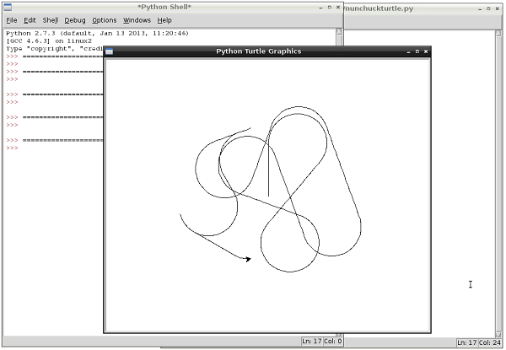
The turtle Module

Slide 45
The turtle Module
>>> import turtle
>>> help(turtle) #Read the docstring

Slide 46
Important functions
turtle.foward(a) – Move forward a distance a
turtle.left(ang) – Turn left by an angle ang
turtle.right(ang) – Turn right by an angle ang
turtle.backward(a)
turtle.penup() – Stop drawing when you move
turtle.pendown() – Draw when you move

Slide 47
MOVING FORWARD
turtle.forward(a)
– moves the turtle a distance a forward

Slide 48
TURNING LEFT or RIGHT
turtle.left/right(theta)
– turns the turtle through an angle theta

Slide 49
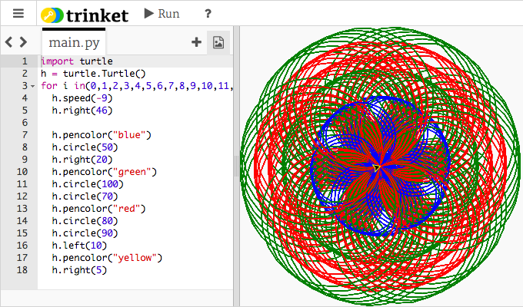
LOOPS
USING THE PYTHON TURTLE TO DRAW A SQUARE IN A LOOP

Slide 50
CODE
import turtle
turtle.speed(0.99999)
for i in range(4):
turtle.forward(100)
turtle.right(90)

Slide 51
RECOGNISE THE VARIABLES
import turtle
turtle.speed(0.99999)
for i in range(4):
turtle.forward(100)
turtle.right(90)

Slide 52
import turtle
turtle.speed(0.99999)
for i in range(number_of_sides):
turtle.forward(length_of_side)
turtle.right(angle)
Notes:
Use variables to allow this program to draw any regular shape using a user’s input

Slide 53
Examples 6.3: Shooting range for programmers

Slide 54
There are 2 kinds of loops:
1. Repeat code exactly # times
2. Repeat code until something is true.
Notes:
1. We know how many times we want to repeat
2. We don’t know how many times we want to repeat, but we know we want to repeat until something happens

Slide 55
1. Repeat code exactly # times
for i in range(low,high):
instructions
Here there is no True or False condition, the computer just repeats the instructions for the specified number of times.

Slide 56
2. Repeat code until something happens
while (condition):
instructions
#This means while this condition is True, keep repeating the instructions below
These instructions will be executed as long as the condition is True

Slide 57
Choosing the correct loop

Slide 58
Loop Examples
1. i = 0 while i < 3: print(“hi”) i = i + 1 | 2. i = 0 while i < 3: print(“hi”) i = i + 1 print(“bye”) | 3. i = 0 while i < 3: i = i + 1 print(i) | 4. x = 5 i = 0 while i < 3: x = x + 1 i = i + 1 print(x) | 5. i = 1 while i < 3: print(“hi”) i = i + 1
6. i = 3 while i > 0: print(“gwc”) i = i - 1 | 7. i = 1 while i: print(“FOREVA!”) | 8. i = 1 while i < 1: print(“w00t”) | 9. i = 0 while i < 5: j = 0 print (“j back to 0”) while j < 2: print(“double time”) | 10. i = 1 while i < 100: print(“omg”) i = i * 100

Slide 59
Answer 2
import random
number = random.randit(0,1024)
g = n + 1
while g != number:
g = int(input(“What is your guess? “))
if g < n:
print(g,”is less than my number”)
elif g > n:
print(g,”is greater than my number”)
print(“Congratulations, you won!”)
print(“Indeed, the number is”, number)

Slide 60
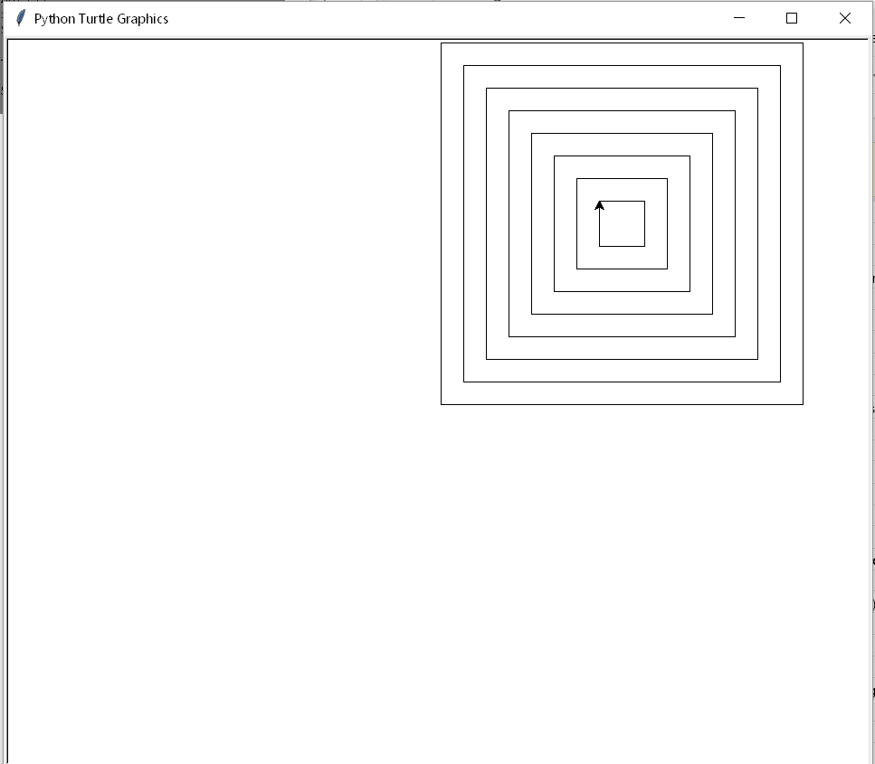
Examples 6.5: Classic Loop Examples

